Slide 1
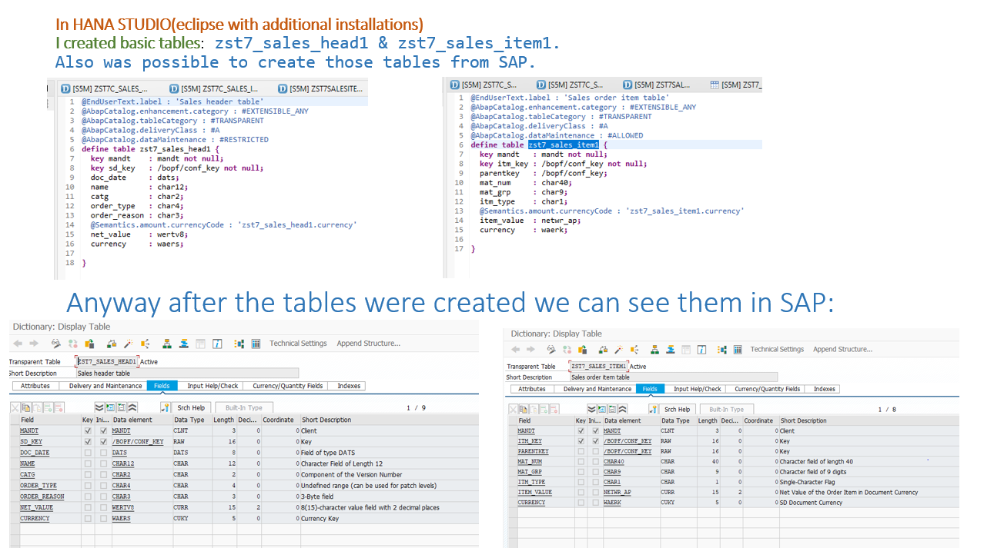

Slide 2
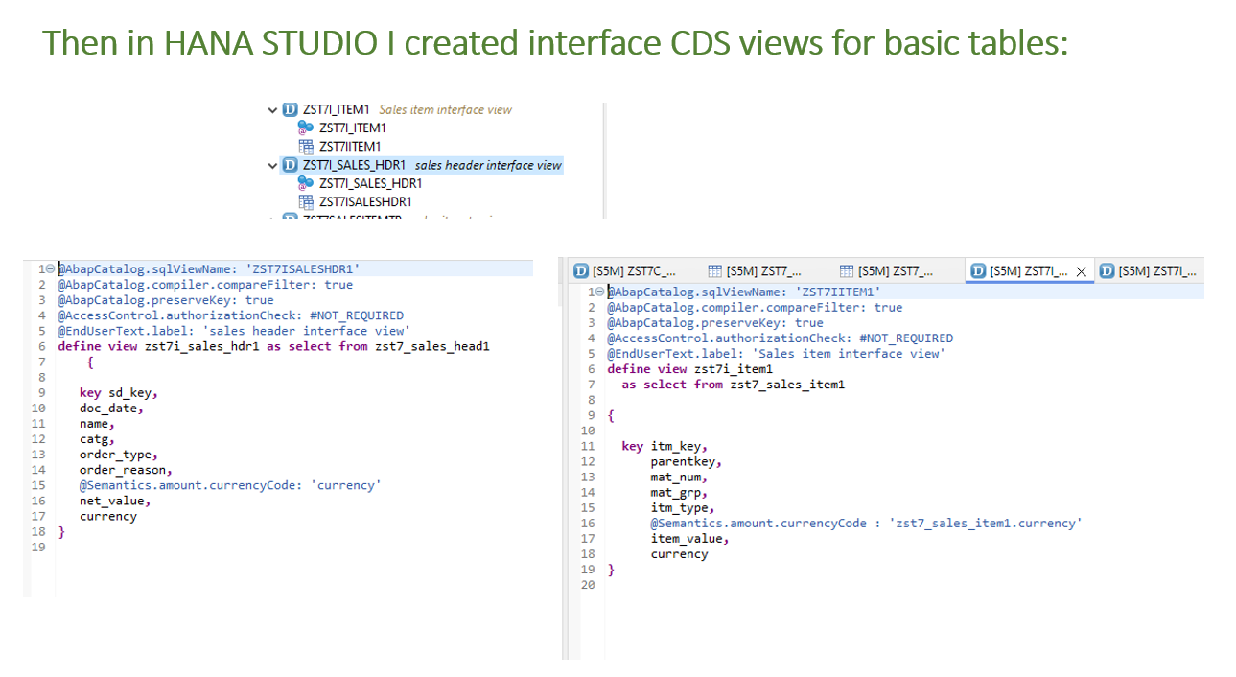

Slide 3
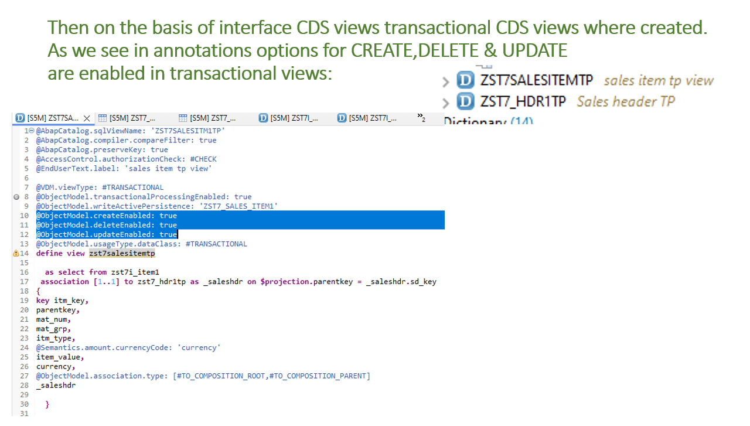

Slide 4
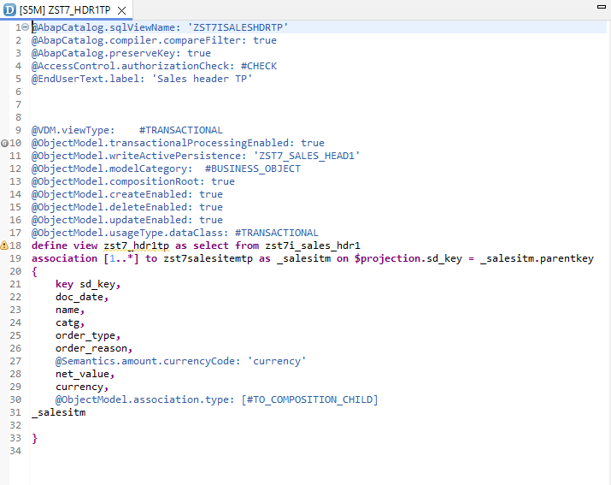

Slide 5
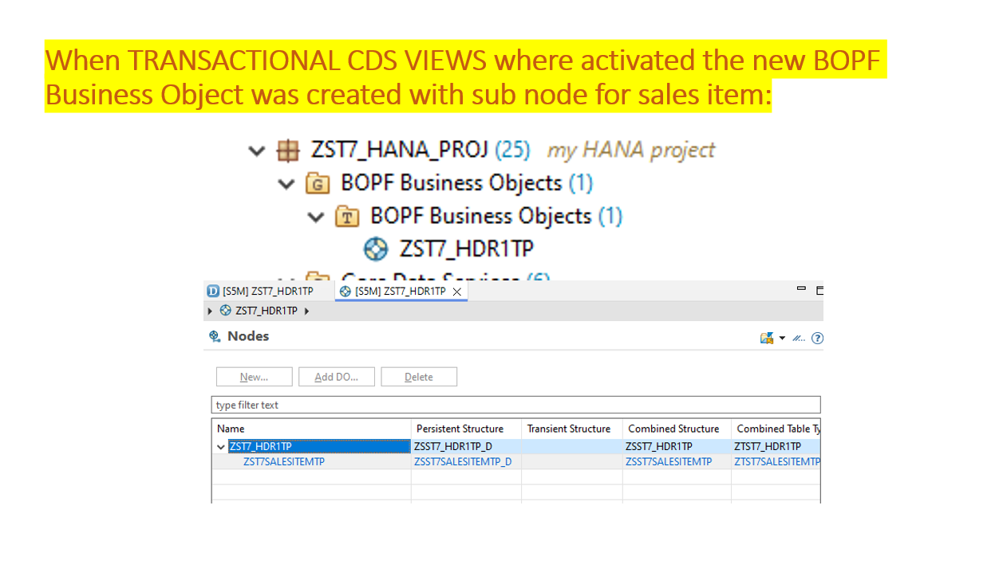

Slide 6
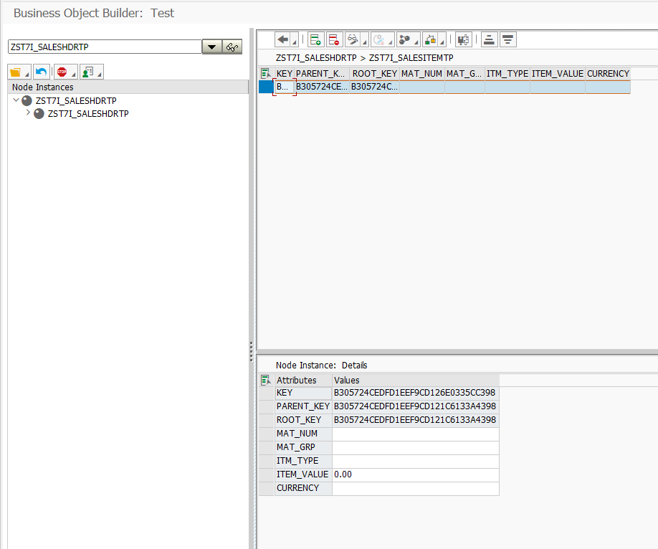
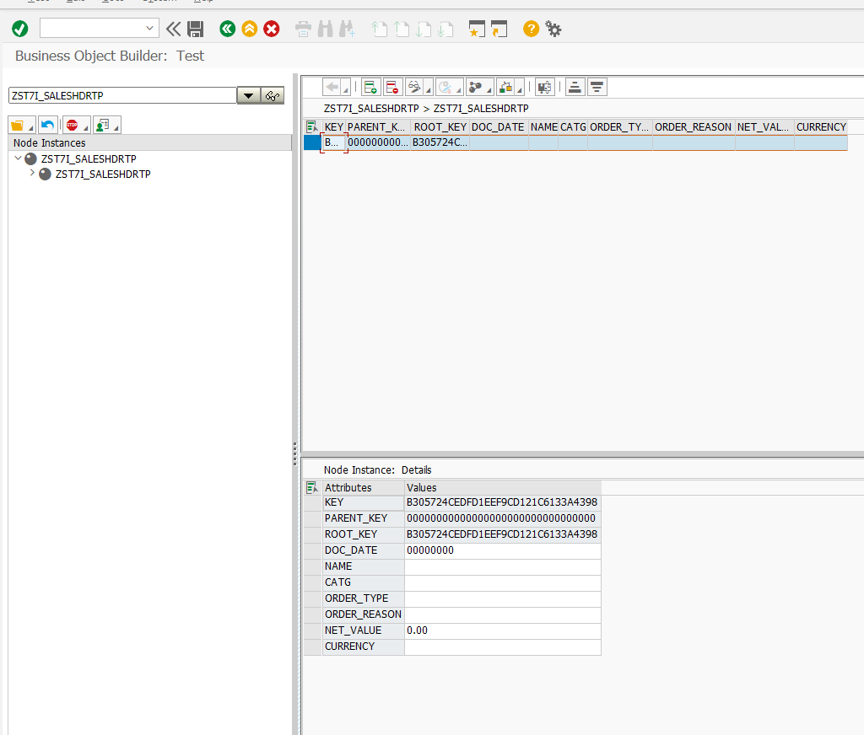
Created BUSINESS OBJECT may be maintained in SAP system from transaction BOBT

Slide 7
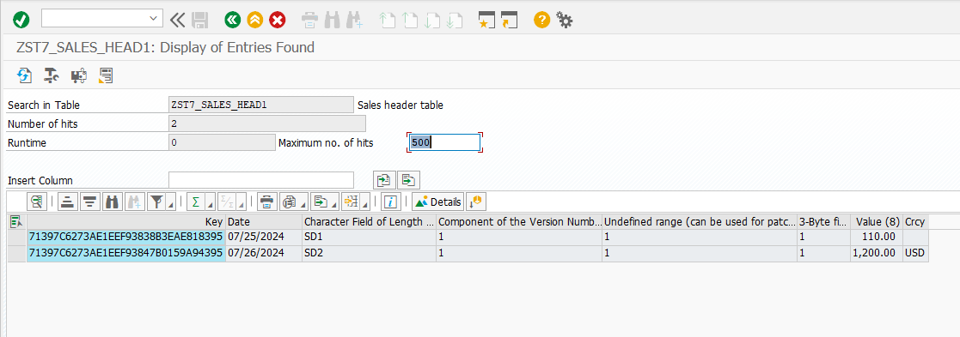
In transaction BOBT data may be entered into the business object
& after that DATA MAY BE SEEN IN DATA DICTIONARY:

Slide 8
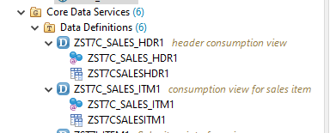
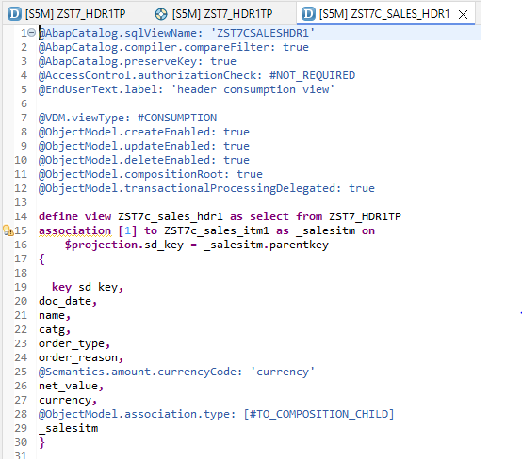
Then CONSUMPTION CDS VIEWS where created for the TRANSACTION PROCESSING CDS VIEWS:

Slide 9
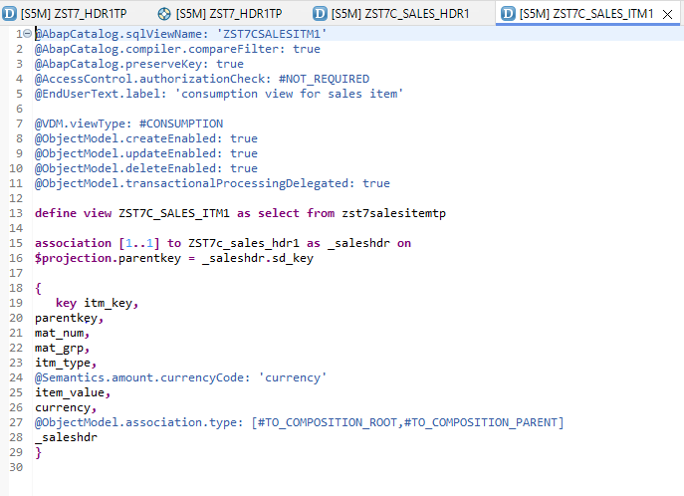

Slide 10
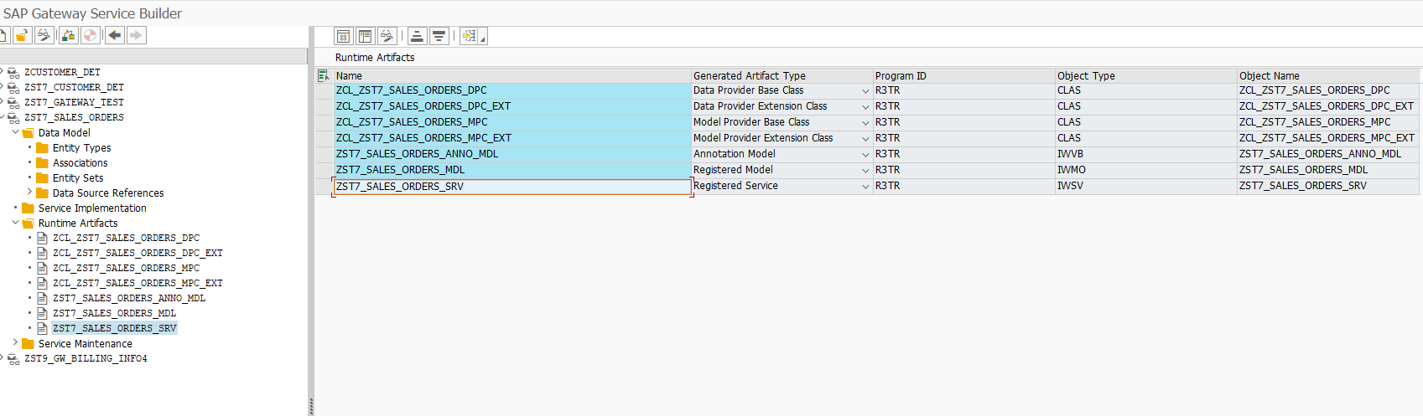
Once the consumption views where successfully activated, we are now ready to create the ODATA object & expose these as services to the outside world.
In transaction SEGW the ODATA service ZST7_SALES_ORDERS_SRV was created

Slide 11
The ODATA SERVISE ZST7_SALES_ORDERS1_SRV was successfully created.
Now we must go to transaction /IWFND/MAINT_SERVICE in order to maintain the service.
First th service must be added :

Slide 12
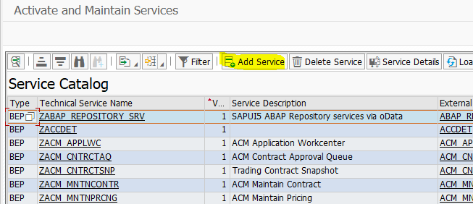
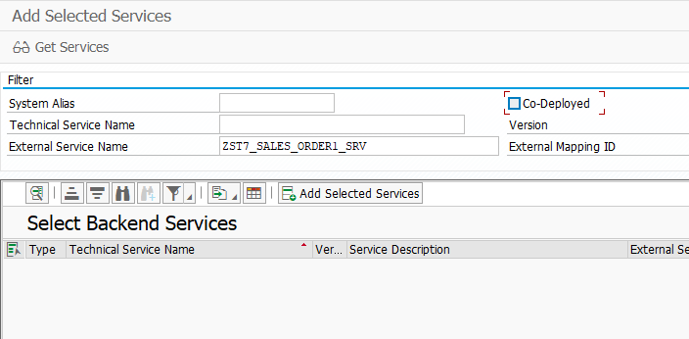

Slide 13
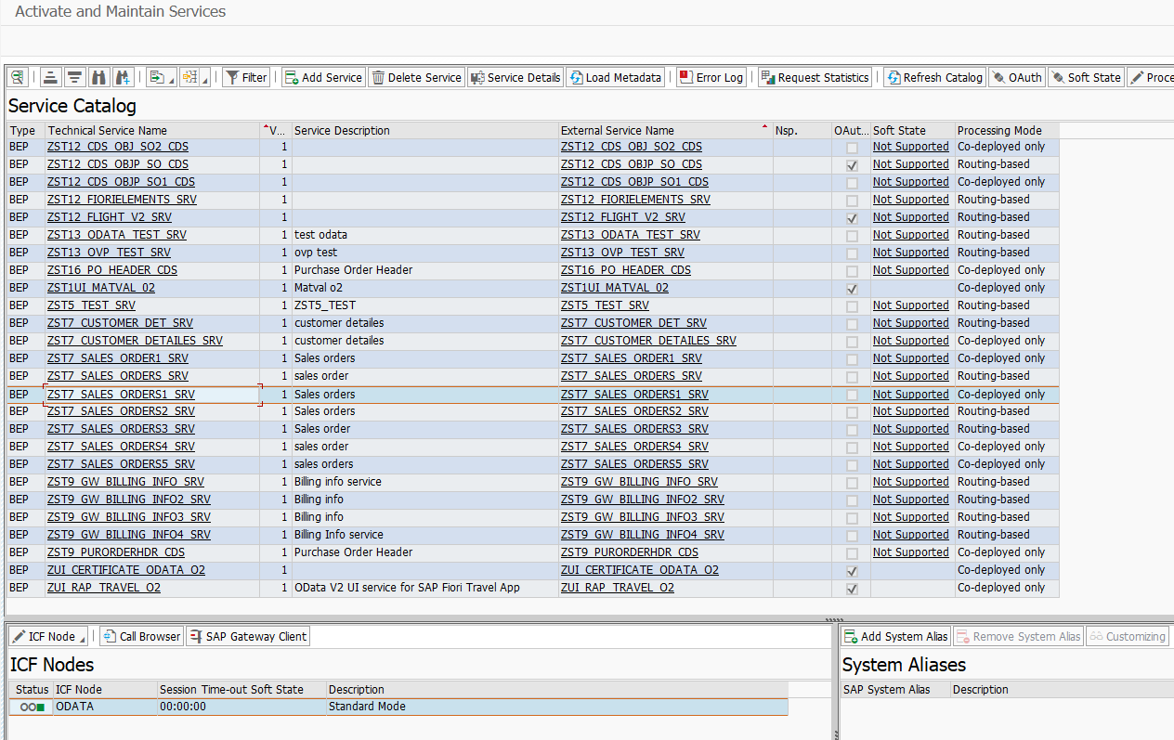

Slide 14
Now we can go to the gateway client - transaction /IWFND/GW_CLIENT- & check if the metadata is loading successfully.

Slide 15
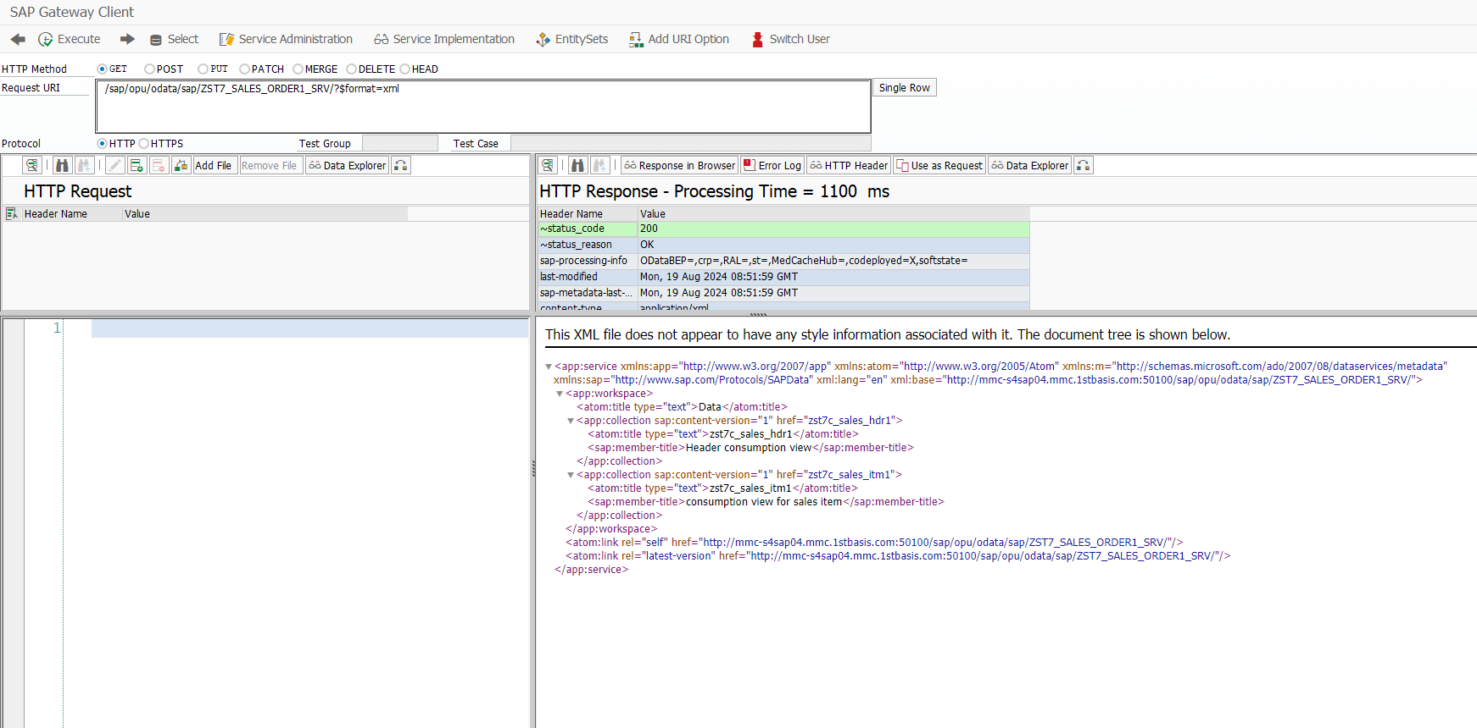
DATA LOADED SUCCESSFULLY!

